Slide 1

Final Project Utilizing Transformers CNN for Classifying Animated Works by Media Type
Yuvraj Puri
CSCI E-82 Advanced Machine Learning, Data Mining, and Artificial Intelligence
Fall 2024
Harvard Extension School

Slide 2
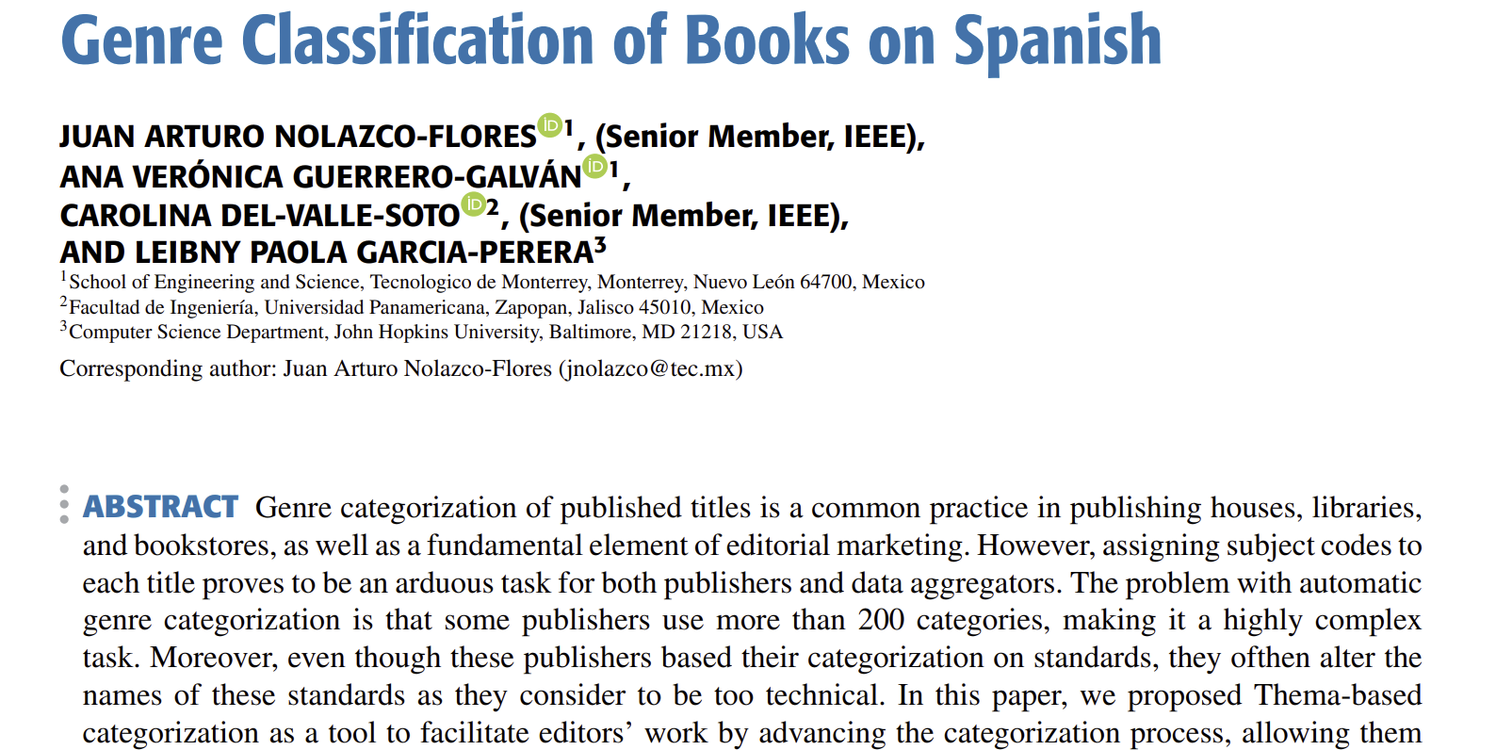
Introduction
This final project extends the research paper titled “Genre classification of books on Spanish”.
The authors applied transformers models to classify books based on a self-devised Latin-American Thema-categorization standard.
Utilized BERT and RoBERTa models to classify books by genre using their descriptions.
Our work extends the paper by:
Utilizing multilingual transformer to classify animated shows by media-type, using their titles. Showing transformer’s domain adaptation capability.
Gathering insights as to how or why each model may show success or fail to predict – which separations are harder to make or predict between classes.

Slide 3
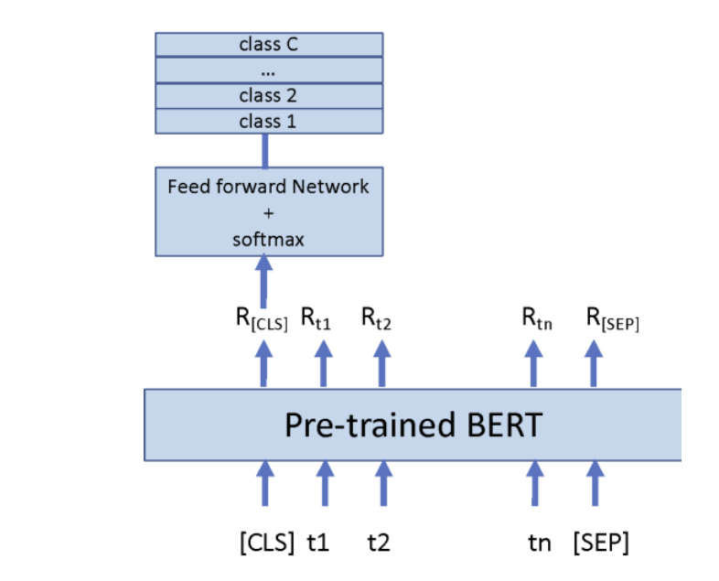
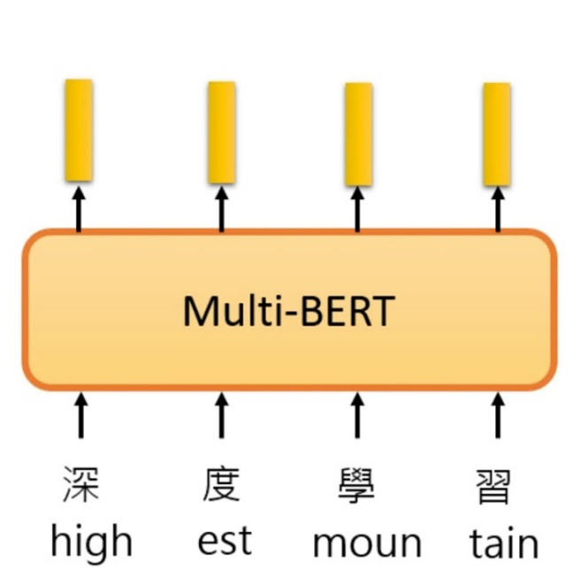
(Multilingual) Transformer
What is BERT?
-BERT: bidirectional encoder representation from transformers. It encodes the input features which is used as a feature extractor. Uses bidirectional training to consider the previous and next tokens, granting it context.
It is pretrained on a large corpus of text in a self-supervised fashion.
Here, we are using it for Text classification.
The multilingual cased model is trained on 104 languages, including Japanese, Chinese, and even capable of parsing Romaji. This model is primarily aimed at being fine-tuned on tasks that use the whole sentence to make decisions, such as sequence classification, token classification or question answering.
As anime titles are a mixture of English and Romaji, we will utilize the multilingual model for classification..

Slide 4
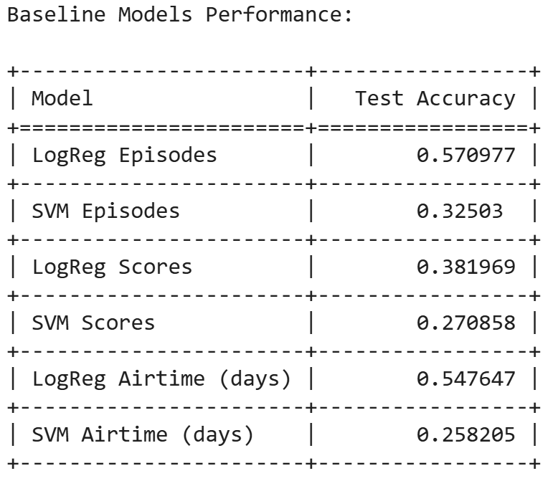
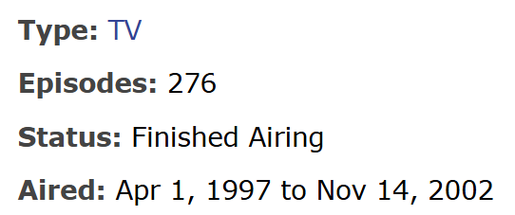
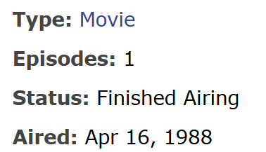
Comparing Models (1/3): Baseline Models
Highest baseline model performance is for Logistic regression episode count and airtime in days – 57% test accuracy and 54.7% test accuracy.
Existing trend between episode count / airtime and whether or not something is a show. May have made use of such a linear separation.

Slide 5
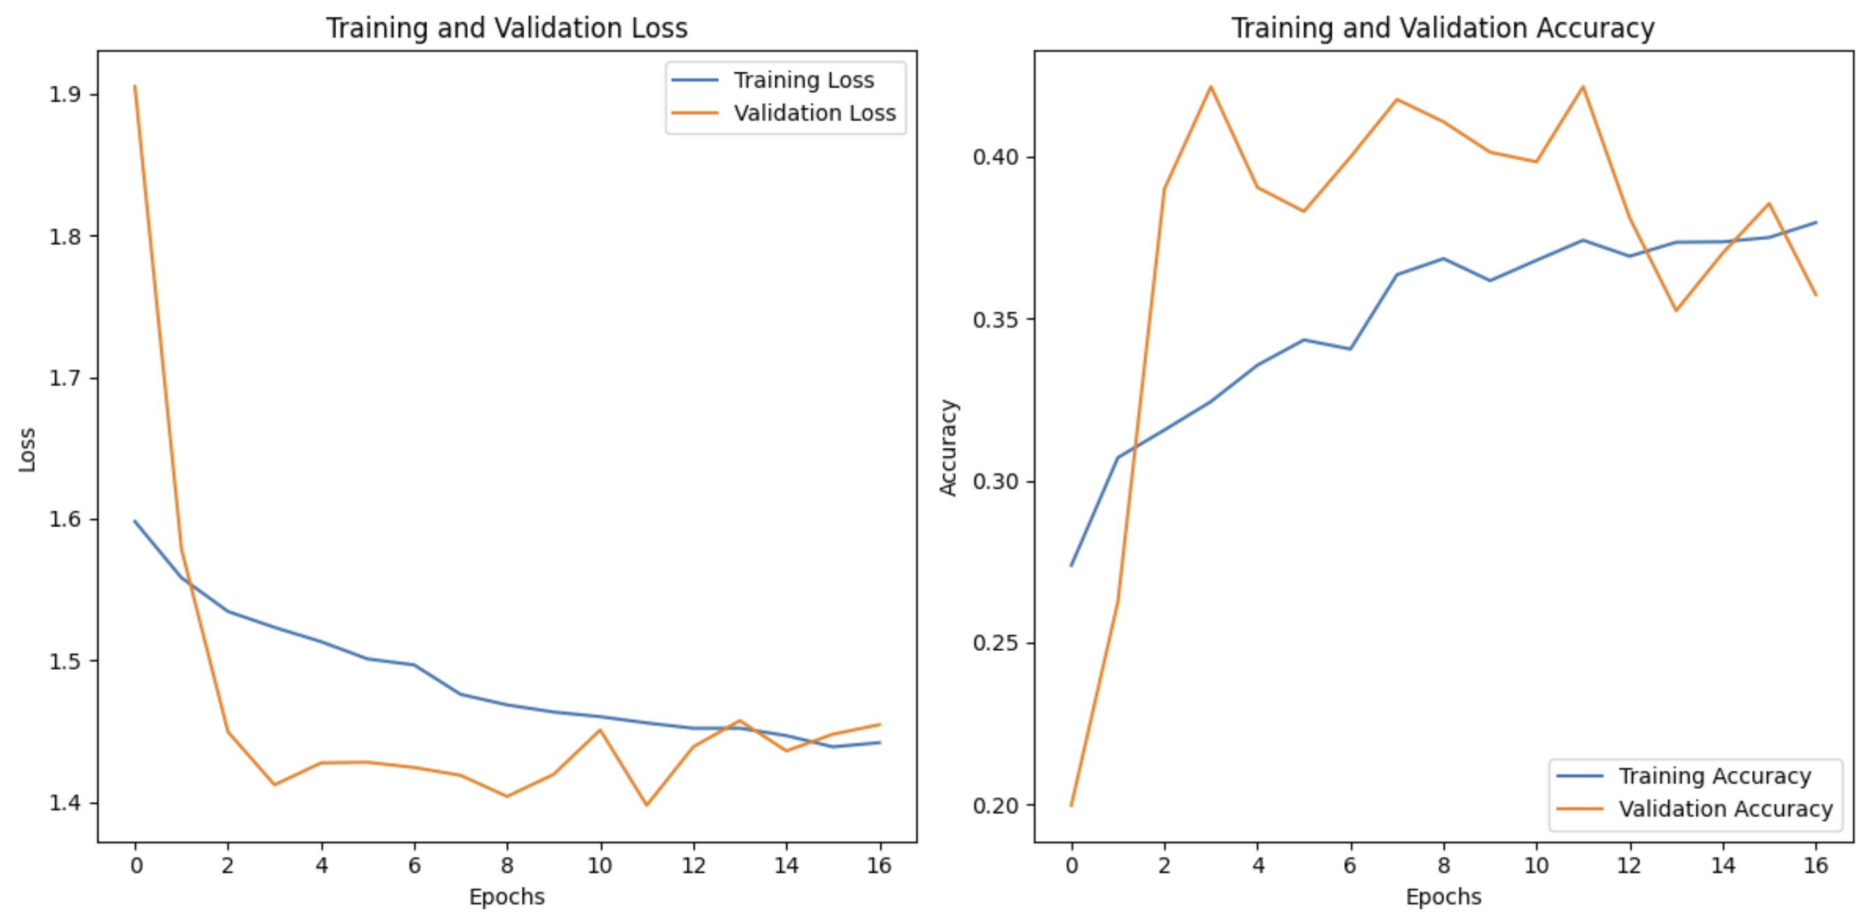
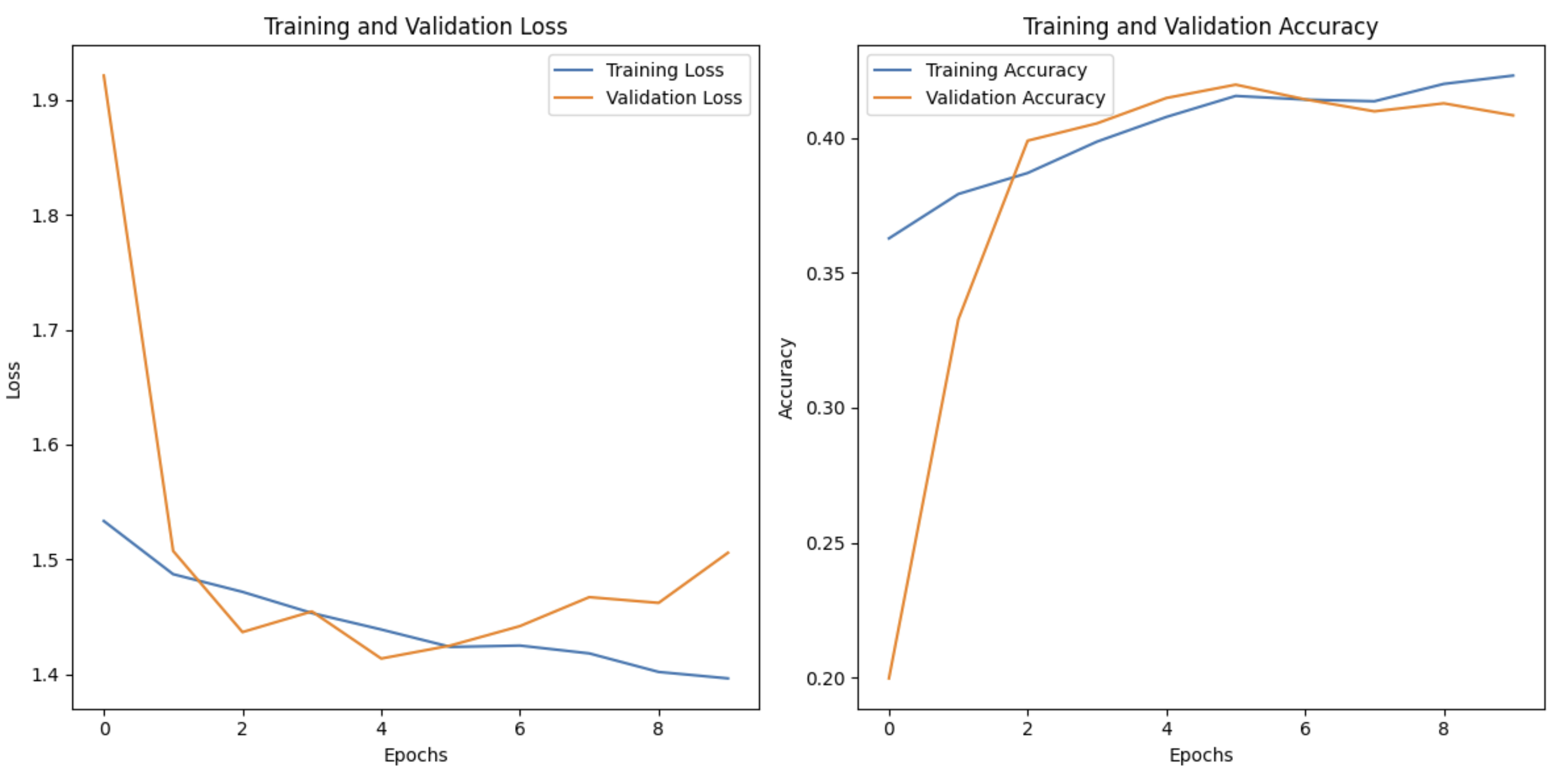
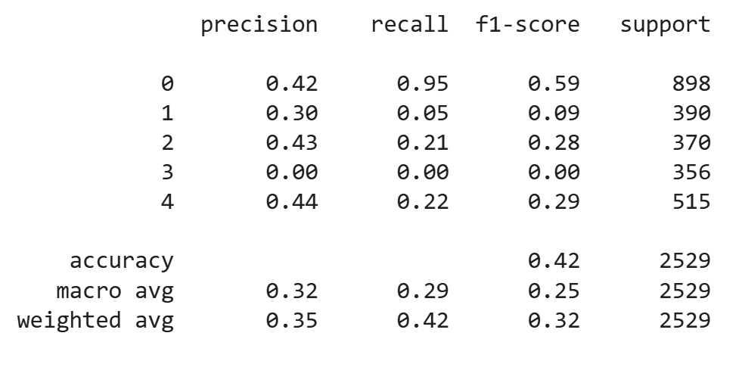
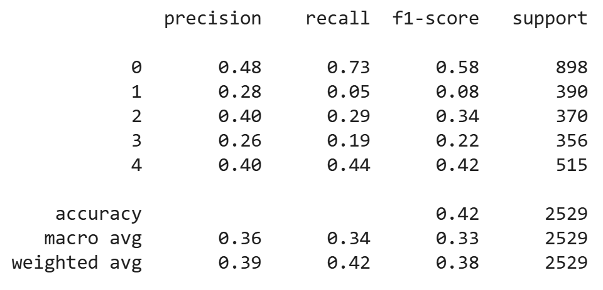
Comparing Models (2/3): CNN Models
Test acc of 42.15%. No class weights.
Completely does not predict OVAs. Very low F1 for specials.
Test acc of 42.47%.
Marginal improvement using weights. F1 is much better for OVA and movies, improved for ONAs. Specials haven’t shown much improvement.

Slide 6
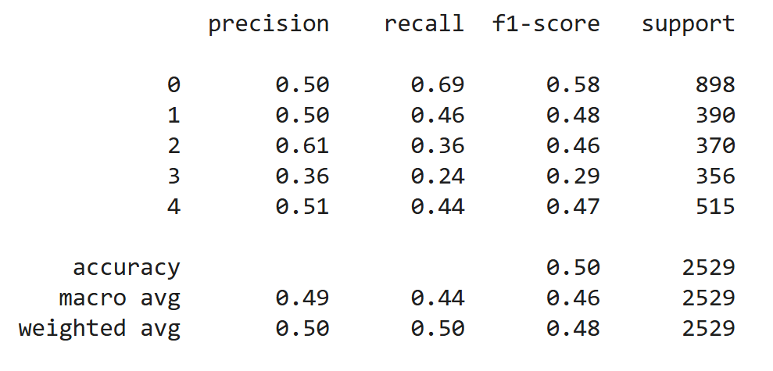
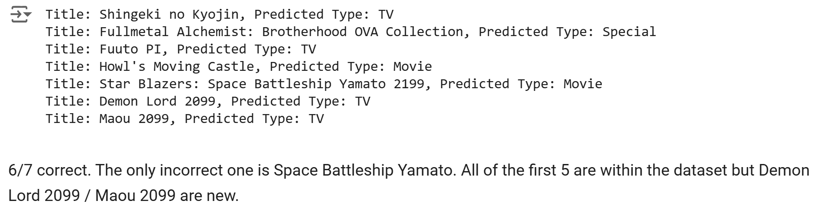
Comparing Models (3/3): multilingual BERT
Best model had Test acc of 0.5030.
It’s not doing a whole lot differently from the final CNN model in that it has pretty much the same F1 for TV shows. It has a slightly better F1 score for OVAs but it has much better F1 scores for ‘Specials’ and ‘ONAs’. It’s slightly better than the CNN model for Movies, too.
Note that the model did predict the second example correctly, despite the confusing name.

Slide 7
Conclusions, Future Directions
Conclusions:
Despite how descriptive the titles of modern animated shows are, our baseline models outperformed our transformer model and our CNN model.
Some of this may be attributed to undefined or unexplored boundaries between each media type.
Future directions:
Expand utilization of transformer-based predictions to utilizing synopses of shows as they may contain more relevant information for prediction beyond the title.
Augment data using already present alternative titles for shows and backtranslated titles using transformer models.
For further image-based analysis, utilize OCR and text extraction for a potential multimodal model using BERT and CNNs.

Slide 8
Citations
https://arxiv.org/abs/1810.04805
https://huggingface.co/google-bert/bert-base-multilingual-cased
https://cs229.stanford.edu/proj2015/127_report.pdf
https://www.kaggle.com/datasets/aditidutta/bert-base-multilingual-cased
Dataset: https://www.kaggle.com/datasets/nikhil1e9/myanimelist-anime-and-manga/
Extension: J. A. Nolazco-Flores, A. V. Guerrero-Galván, C. Del-Valle-Soto and L. P. Garcia-Perera, "Genre Classification of Books on Spanish," in IEEE Access, vol. 11, pp. 132878-132892, 2023, doi: 10.1109/ACCESS.2023.3332997.

